Slide 1
Manipal Call Cental Analysis
Name : Punay Mehra
Reg No. : 17225760041

Slide 2
CAPACITY OF CALL CENTRE : 40 – COUNSELLORS 02 – TL 01 - MANAGER
GIVEN ACCESS TO THE FOLLOWING DATABASE :
Digital leads generated source wise
Source wise enrollment
Month wise lead for March, April and May
Month wise revenue for March, April and May

Slide 3
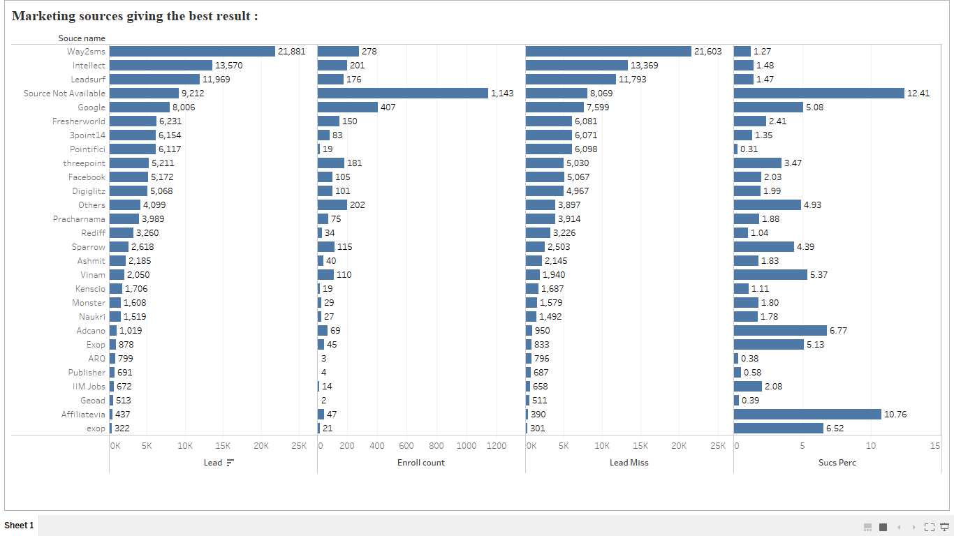
Marketing source giving the best result : Content Layout with Chart
This data is taken from the database of source wise enrolment.
From the dataset , the marketing source which gives more leads is “ Way 2 sms ”.
The source through which more number of enrollments is done is through “Google”.
The success percentage of enrolment is more in “ Affilatevia ”.

Slide 4
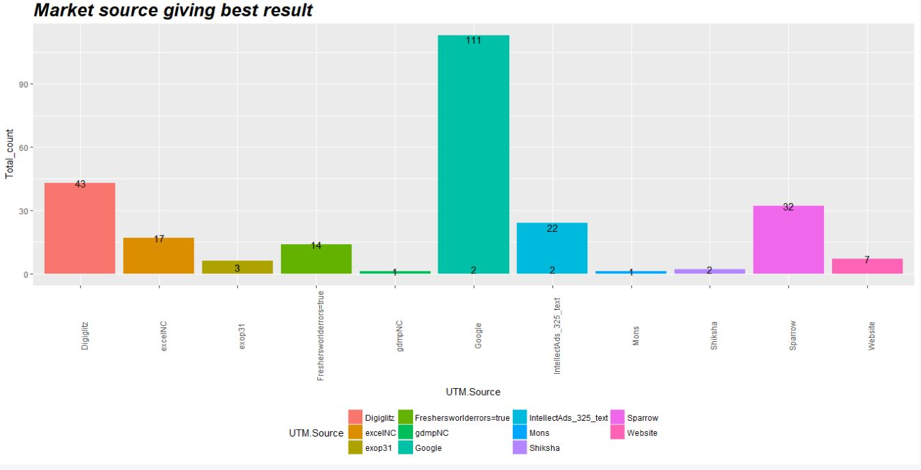
Justification of analysis :

Slide 5
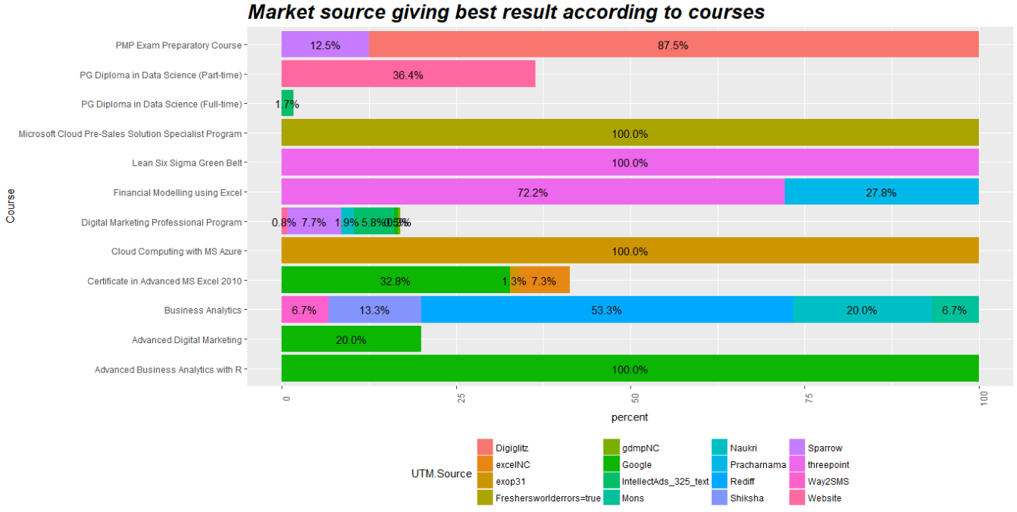
Marketing source giving the best result: percentage of enrolment in courses through sources
The data is displaying the percentage of enrolment in every course from the leads generated from different sources

Slide 6
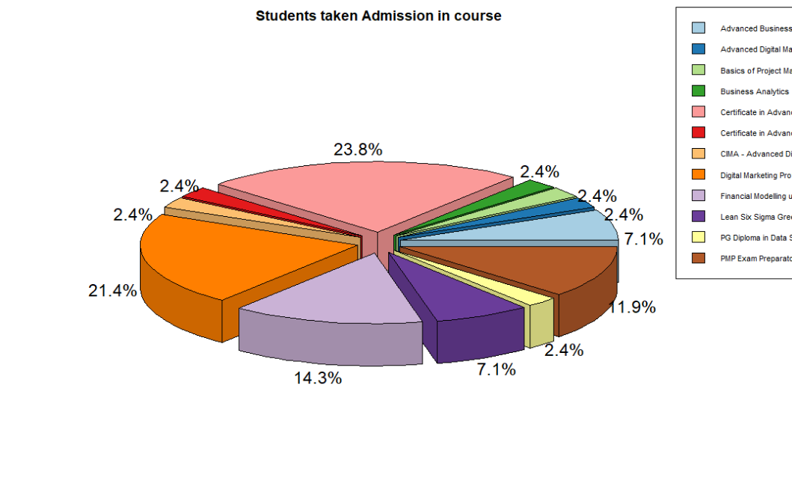
Product should be focused more with respect to enrolment in courses
The data shows the courses(products) wise percentage of admission taken
The minimum number of admissions are in Advanced Digital Marketing, Basics of Project Management, Business Analytics , PG Diploma in Data Science (Full-time), Certificate in Advanced MS Excel 2016
We should focus on the product with minimum enrolments by advertising and training to improve convincing power of employees

Slide 7
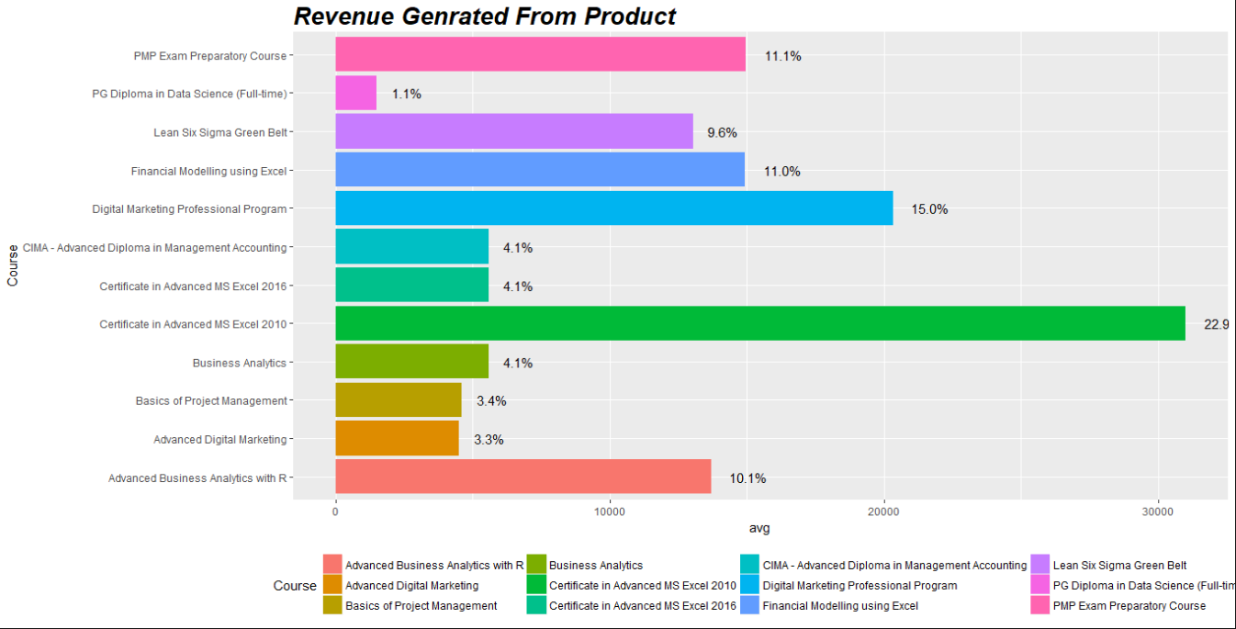
Product should be focused more with respect Revenue generated from employment
The data shows the courses(products) wise percentage of Revenue generated from products
The minimum number of admissions are in PG Diploma in Data Science (Full-time)
We should focus on the product with minimum revenue by working on the cost of product and improving the advertising and convincing skills of employees

Slide 8
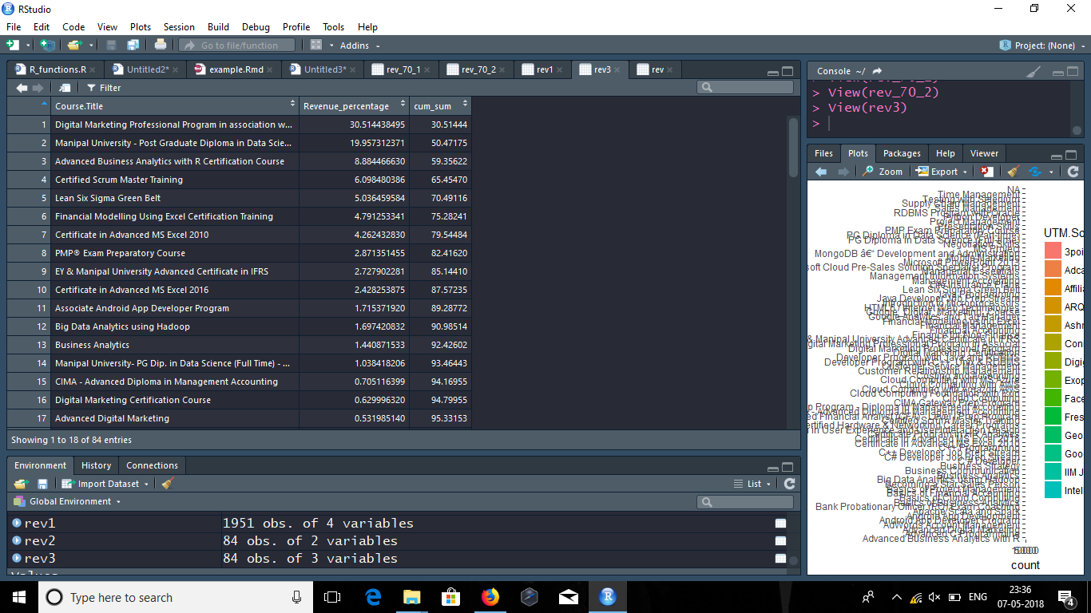

Which product to focus more :

Slide 9
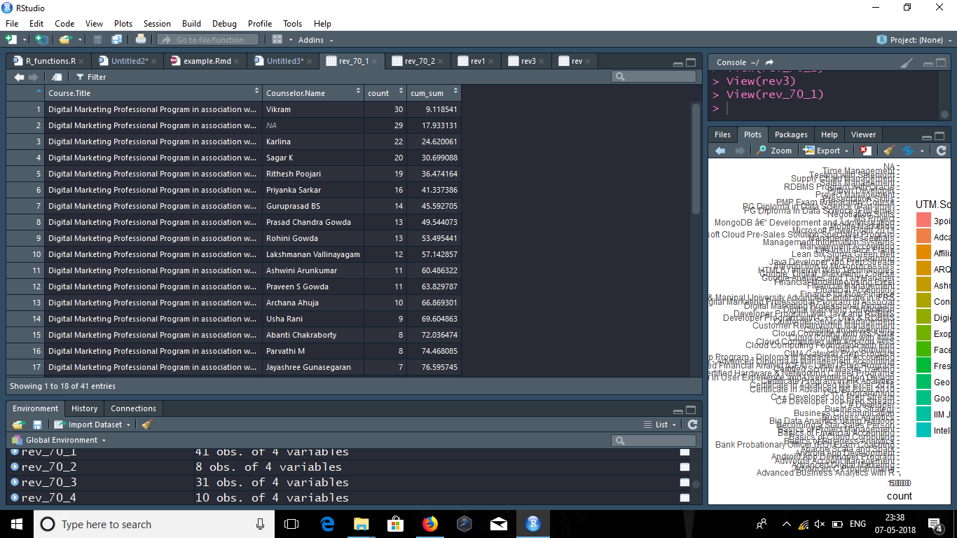
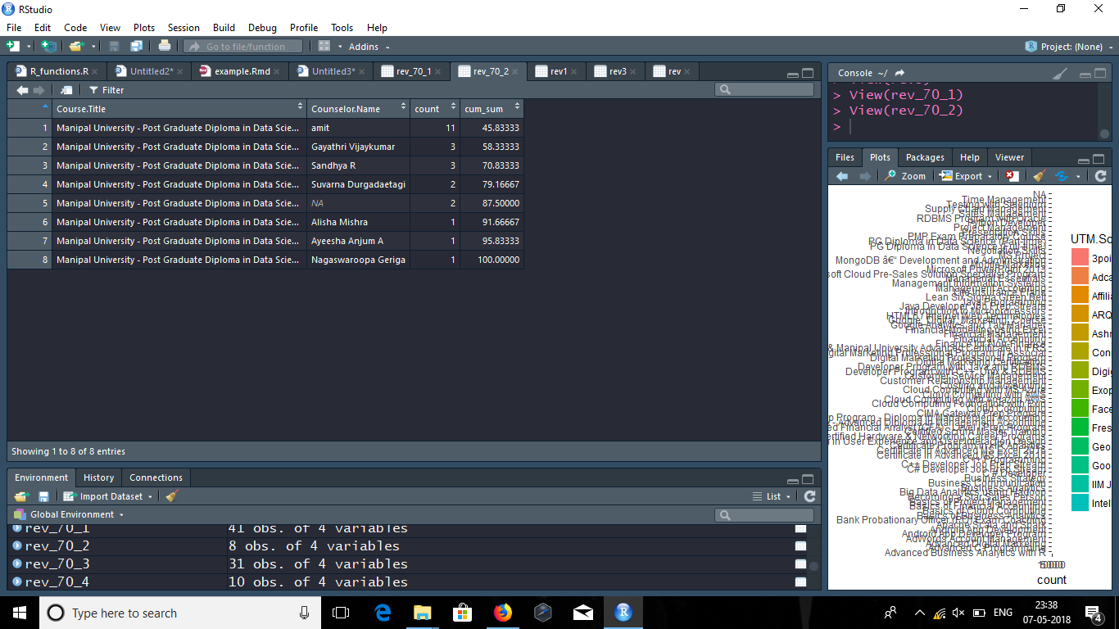
Revenue generated by counsellors by number of successful admission as per successful payment status (top 5 courses) :

Slide 10
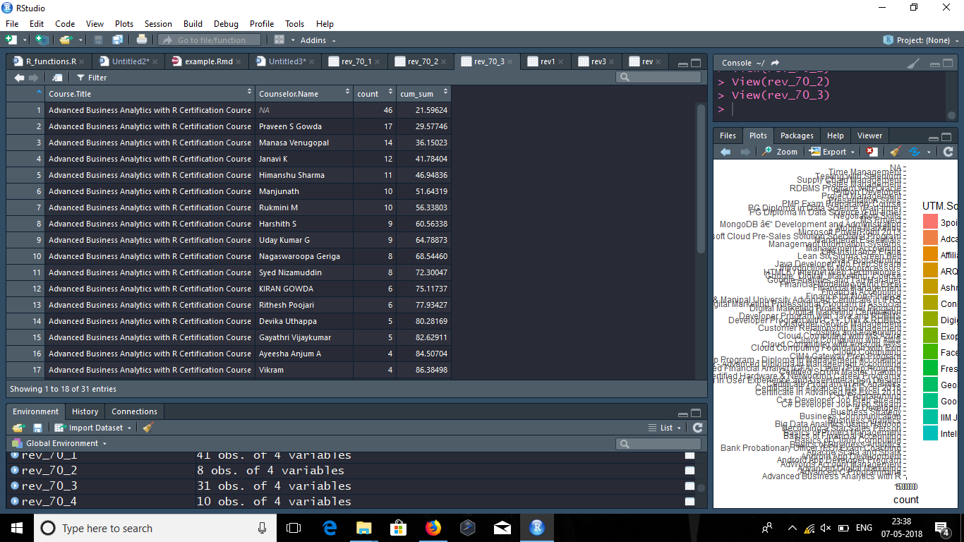

Revenue generated by counsellors by number of successful admission as per successful payment status (top 5 courses) :

Slide 11
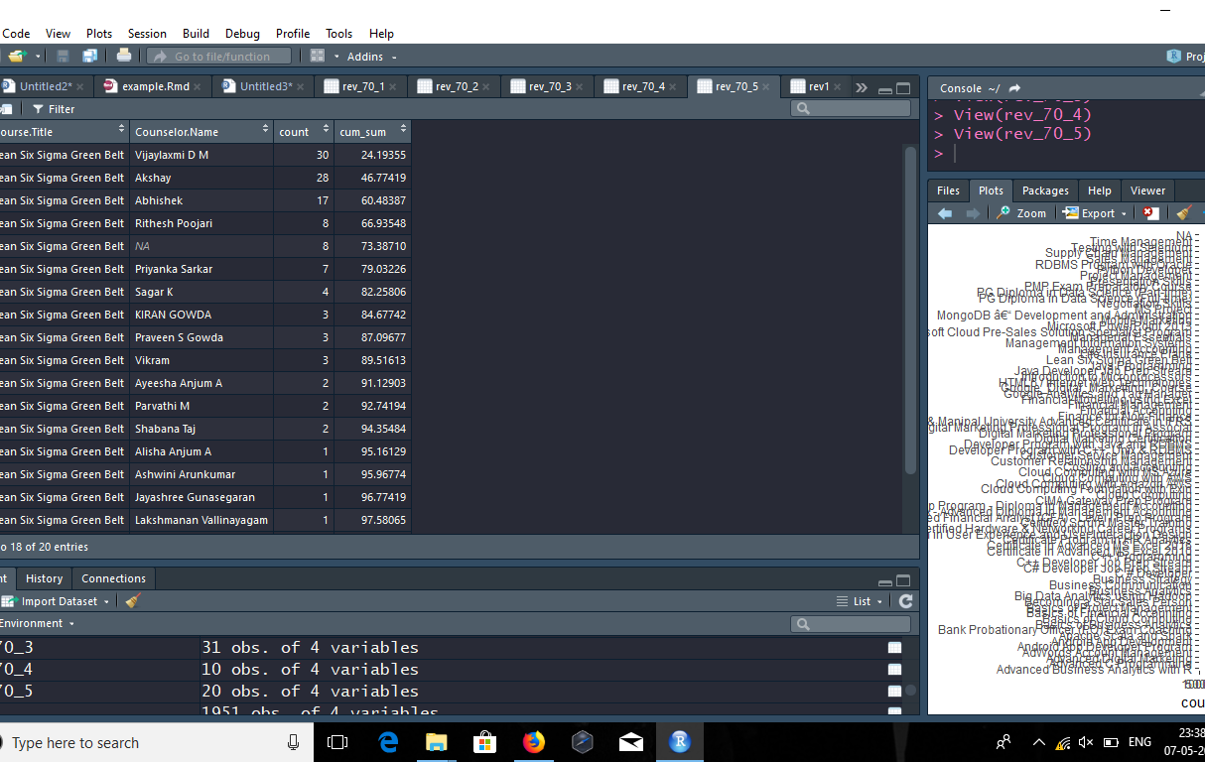
Revenue generated by counsellors by number of successful admission as per successful payment status (top 5 courses) :

Slide 12
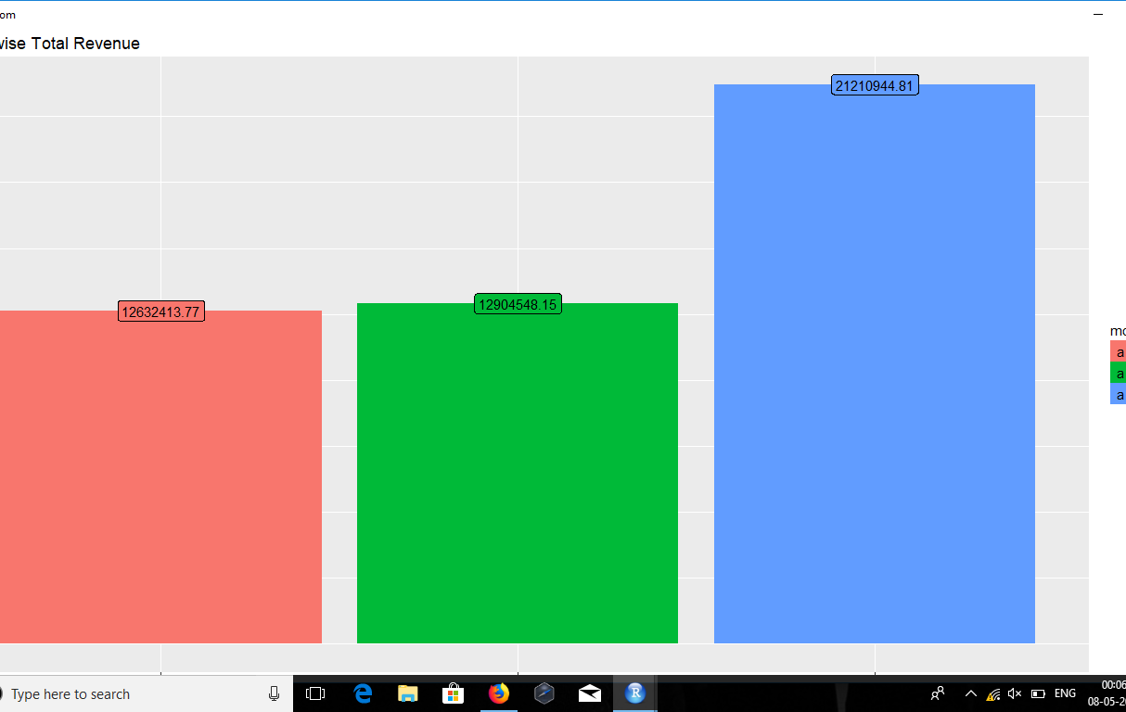
Bar chart showing monthly revenue :

Slide 13
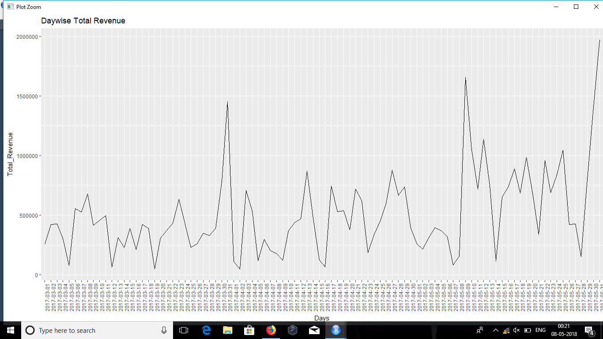
Trend analysis on daily basis as per given data :

Slide 14
Which product to focus more :
Our approach towards the product upon which we should focus is as follows :-
According to Pareto principle , 80 % of the revenue comes from the 20 % of the source , so here we calculated the total revenue generated through the admission taken.
We found that out of 84 courses only 5 courses contribute to the 70% of the total revenue.
There are 4 courses among these courses where 0% enrolment has done .
Our approach should be that we should have to focus more on those products where the revenue is generating because there only less number of courses where we need to concentrate from which we are getting maximum revenue .
We should not try to spend more on concentrating the less revenue courses because there are many courses of such…
We should try to market those low revenue courses in the source for which the leads are more for top 5 courses.
For this we have plotted graph where we can find through which marketing source how many leads are generated for a particular course .

Slide 15
Strategy for workforce :
For the strategy of workforce, we took how many counsellors are converting leads to enrols.
We again divided them as per Pareto rule and we found that among those 40 counsellors the following are the number of counsellors who are contributing to more than 70% of the total revenue :
Digital marketing : 14 counsellors
Data Science : 3 counsellors
Business analytics with R : 10 counsellors
Certified Scrum : 3 counsellors
Six sigma green belt : 5 counsellors
For the above counsellors we should have to assign them the particular products where they are generating more revenue.
For the rest it depends upon the organisation whether to deploye the employee or should be used for generating revenue for remaining courses .
From the leads and enrollments there are two marketing sources which have generated 1990 leads and failed to convert them into

Slide 16
Overall strategy for the call centre :
The overall strategy for the call centre should be as follows :
To concentrate more on those products which are generating more revenue from the rest, for low revenue products we should have to market those products in the sources which are getting us more leads and revenue from the all.
35 counsellors are enough to run the call centre , instead of spending the amount on those 5 counsellors we can spend the amount in marketing sources for leads and can generate revenue from them.
4 products needed to be excluded from the list as they are not being enrolled by any one for the 3 months as per the given data.

Slide 17
THANK YOU

